Slide 1

Algorithms in the Real World

Slide 2

California High-Speed Rail
Goal: Renewable-powered, lightning-fast travel between SF and LA

Slide 3
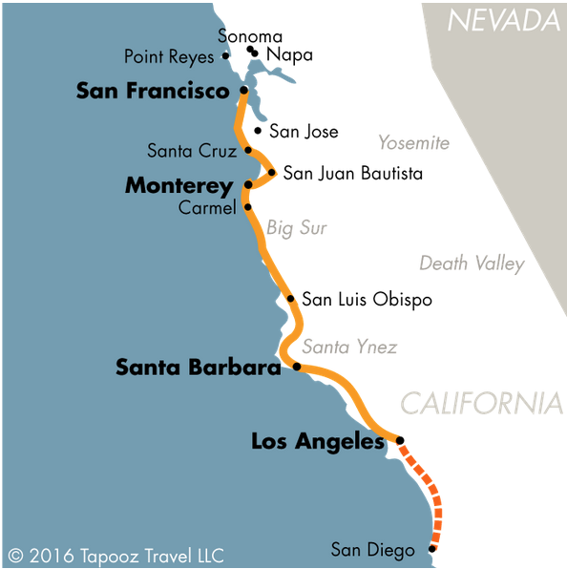
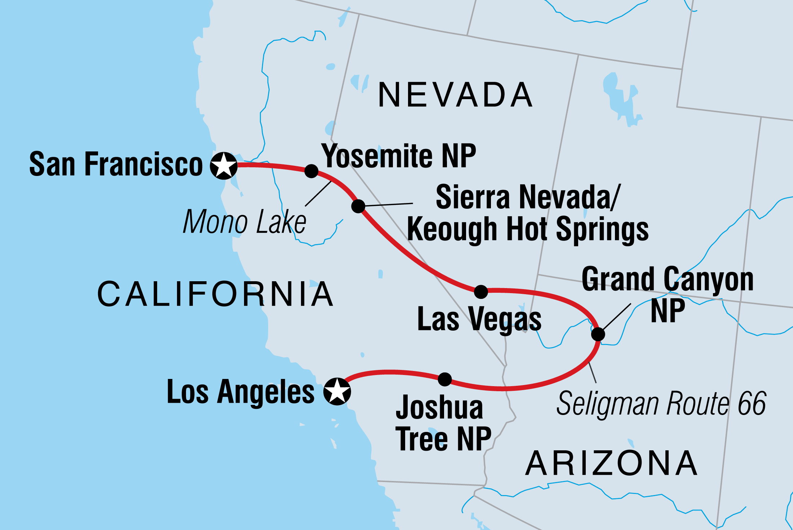
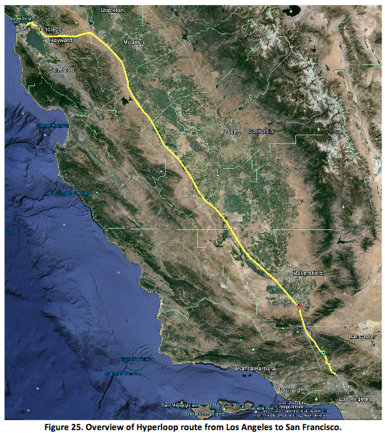
But there are so many different routes we could take!

Slide 4
High-Speed Rail and Algorithms
How could we use an algorithm to find the best route?
What an interesting question! Let’s come back to that in a few weeks…
Okay… how could we use an algorithm to select the best route from a set of proposals?

Slide 5
Today
How can comparison-based algorithms help us with real world problems (and how can they not help us)?
Representing rail route selection as an algorithms problem
Comparison challenges: incommensurability
Measurement: problems with proxies, estimation

Slide 6
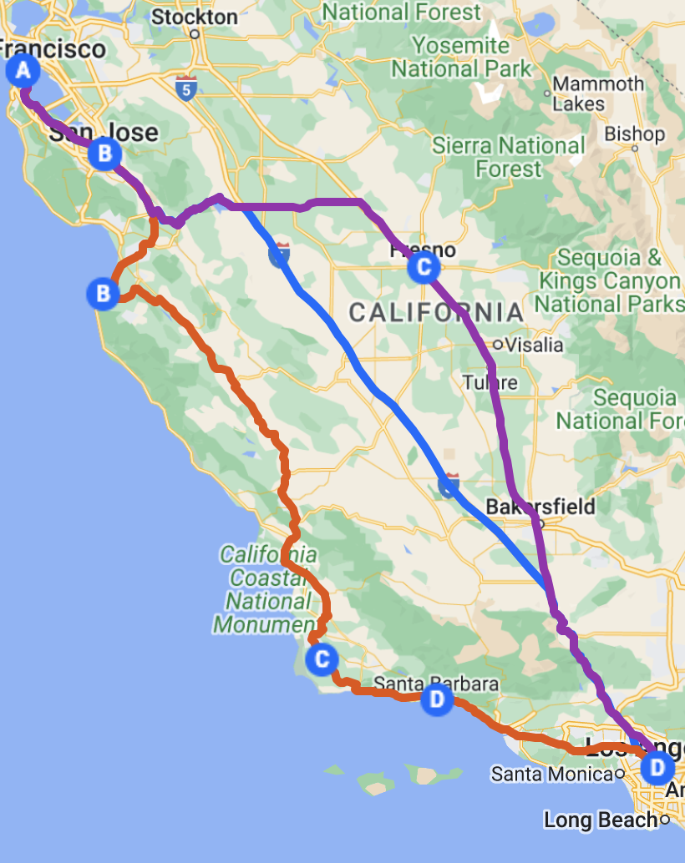
Suppose you have a big stack of route proposals…
Route Name | Time SF -> LA (min)
Coastal | 180
I-5 Express | 135
Eastern Valley | 160
… | …
… | …

Slide 7
… and you want to consider them one by one, from most to least promising.
Route Name | Time SF -> LA (min)
Coastal | 180
I-5 Express | 135
Eastern Valley | 160
… | …
… | …
Notes:
Let’s say you can’t just pick the best one right away because you need to independently verify the estimates in each proposal, so you might need to look at more than one to find the best. Still, you’d rather start with the most promising ones, rather than waste your time with proposals that wouldn’t be good even if they’re correct.

Slide 8
How could an algorithm help you here?
Route Name | Time SF -> LA (min)
Coastal | 180
I-5 Express | 135
Eastern Valley | 160
… | …
… | …

Slide 9
Sort the list (by time)!
Route Name | Time SF -> LA (min)
I-5 Express | 135
… | …
… | …
Eastern Valley | 160
… | …

Slide 10
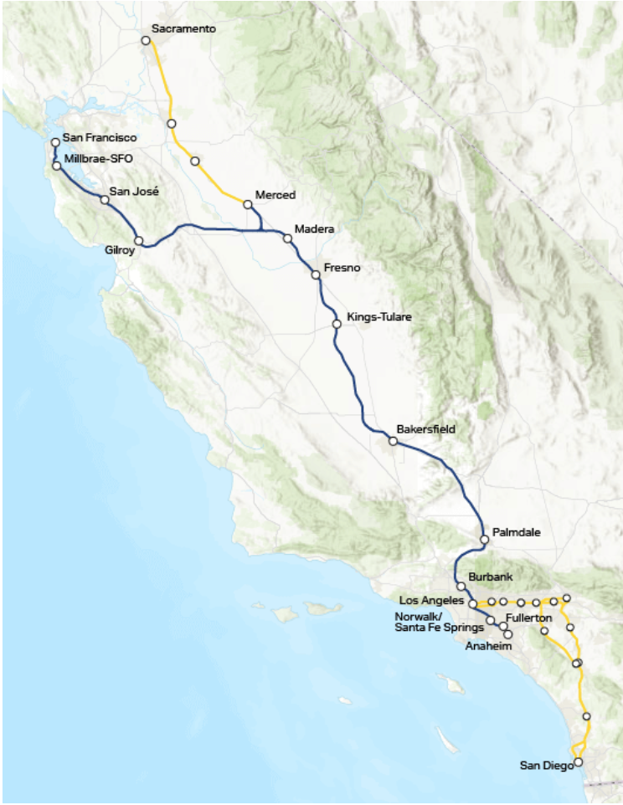
That’s not the route they’re actually planning to build, though…

Slide 11

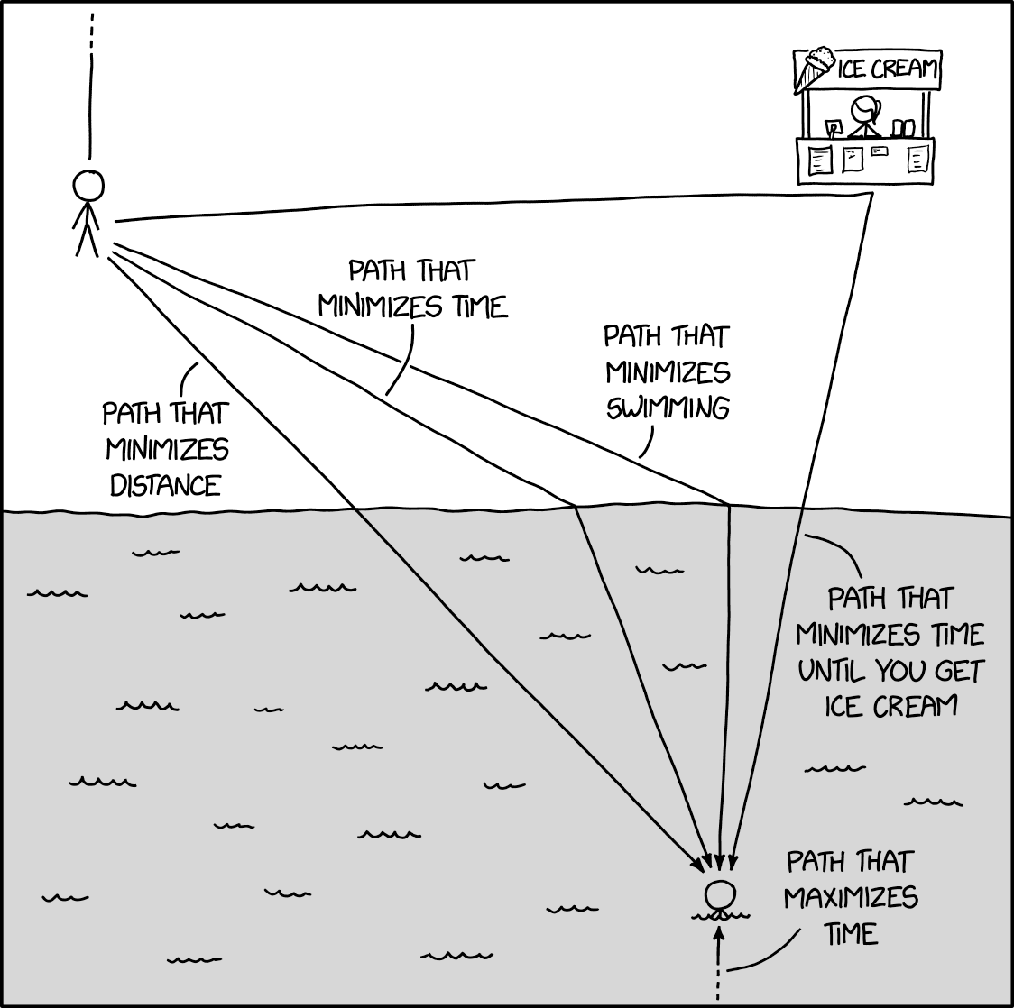
What else might matter for route selection besides speed?
Notes:
Think pair share: What other factors might we want to take into account?
Construction cost or difficulty
Environmental impact (emissions, habitat disruptions, etc.)
Revenue & expenditure
Ridership (convenience, as a factor in emissions, etc.)
Social mobility, but also gentrification (what if Fresno became a bedroom community for SF?)
Which communities are historically underserved?
Eminent domain
Disruption to communities (including native communities)
Views (of or from train)
Shortest time between certain other stops?
Inclusion of certain other stops in the first place?
etc.

Slide 12

Example: emissions
High-speed rail will be entirely powered by renewable-generated electricity
It will reduce carbon emissions primarily by taking cars off the road, so emissions reduction depends on ridership
The state estimates that the eastern route will reduce emissions by ~2 Mmt per year
Would you expect the “direct” I-5 route to reduce emissions by more or less than this?

Slide 13
Taking emissions into account
Suppose we also have emissions reduction estimates for each proposal. How should we sort the proposals now?
Route Name | Time SF -> LA (min) | Emissions reduction (Mmt)
Coastal | 180 | 2
I-5 Express | 135 | 1.5
Eastern Valley | 160 | 2
… | … | …
… | … | …

Slide 14

One way: a weight function
Rather than sorting by time, sort by a function of both time and emissions reduction
We want to rank the proposals from best to worst in terms of some f(t, e), which reduces time and emissions to a single value

Slide 15
Sorting with a weight function
Route Name | Time SF -> LA (min) | Emissions reduction (Mmt) | f(t, e)
Coastal | 180 | 2
I-5 Express | 135 | 1.5
Eastern Valley | 160 | 2
… | … | …
… | … | …

Slide 16
Sorting with a weight function
Problem: which function should we use for f(t, e)?
Route Name | Time SF -> LA (min) | Emissions reduction (Mmt) | f(t, e)
Coastal | 180 | 2 | ???
I-5 Express | 135 | 1.5 | ???
Eastern Valley | 160 | 2 | ???
… | … | … | …
… | … | … | …
Notes:
Another way of asking the question: how do we compare or trade-off between time and emissions? Our choice of f will encode a way of trading off between these two things. What’s the right one?

Slide 17
Comparison is key, but can be hard!
Is there a common measure?
numbers have them
1 < 2; 1==1; 1 > 0
some factors don’t
⏳ v.s. ⛽️
Are our proxy measures appropriate?
What are the pitfalls of trying to determine one value by measuring a different one?

Slide 18

Incommensurability
The First Barrier to Comparison

Slide 19


Incommensurability
Two things are incommensurable if they lack a common measure of value—that is, if there is no single measure that can be used to evaluate both.
Incommensurability makes it difficult to establish measure relationships such as “more than” or “less than, “better than” or “worse than” by how much.
For example, what is the relationship between milliliters (ml) and centimeters (cm)? How would you rank different amounts of water and physical lengths in the same list? You wouldn’t!

Slide 20

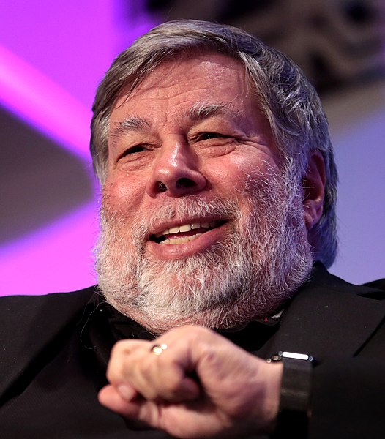


Some things are commensurable
Apple stock and Microsoft stock are commensurable in terms of dollars: we can measure and compare them by dollar value
Touchdowns, field goals, PATs, and safeties are commensurable in terms of points: we can measure and compare them by how many points they’re worth

Slide 21
When two things are commensurable, they can easily be reduced to a single value
f(AAPL, MSFT) = (223.66*AAPL) + (446.71*MSFT)
This function reduces Apple and Microsoft stock to a single dollar value
f(TD, FG, S, EP, TPC) = (6*TD) + (3*FG) + (2*S) + (1*EP) + (2*TPC)
This function reduces touchdowns, field goals, safeties, extra points, and two-point conversions to a single point value

Slide 22
Not so with incommensurable values
What’s the function for reducing career advancement and friendship to a single number?
Or oil and biodiversity?
Or… time and carbon emissions?
We can evaluate route proposals on each scale separately, but what if we need to consider both?

Slide 23
Incommensurable != Incomparable
We might be able to tell that X hours saved is better or worse than Y tons of emissions, even if we can’t say how much better or worse.
(Are there any two things that are truly incomparable?)
Incommensurable
No common measure, but can rank or order
Incomparable
can’t rank or order

Slide 24
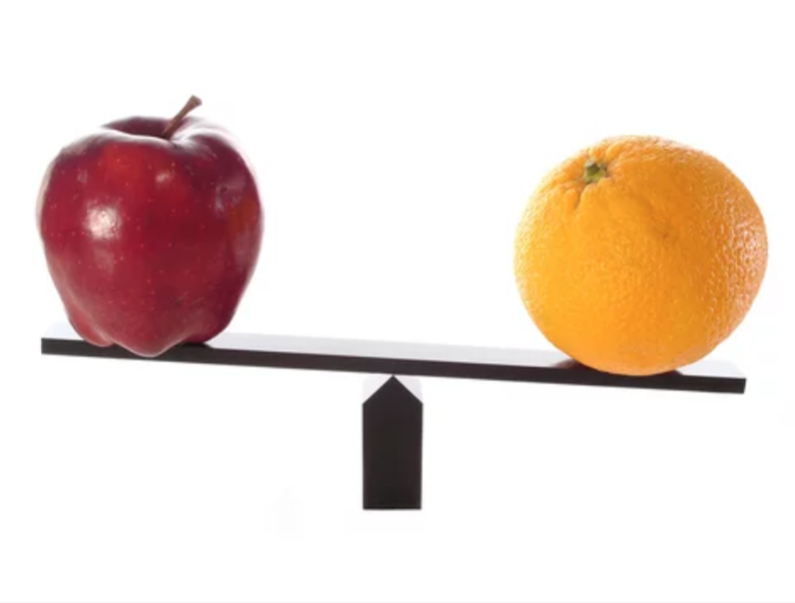
What are some other values that are commensurable? Incommensurable?

Slide 25
Upshot for Algorithms
Many algorithms work best on values that have a built-in standard of comparison, like numbers.
In real-world situations, some problems you might try to formalize and solve algorithmically will include incommensurable values with no obvious standard of comparison.
There might not be a single “optimal” choice, and results will vary depending on how you choose to weigh different values. Technical considerations alone won’t determine the correct weight function.

Slide 26
Back to the problem at hand…
Route Name | Time SF -> LA (min) | Emissions reduction (Mmt) | f(t, e)
Coastal | 180 | 2
I-5 Express | 135 | 1.5
Eastern Valley | 160 | 2
… | … | …
… | … | …

Slide 27
A silly example
Let f(t, e) = t – e
(Why minus?)
(Why do I call this example silly?)
Route Name | Time SF -> LA (min) | Emissions reduction (Mmt) | f(t, e)
Coastal | 180 | 2 | 178
I-5 Express | 135 | 1.5 | 133.5
Eastern Valley | 160 | 2 | 158
… | … | … | …
… | … | … | …
Notes:
e is emissions reduction, so we want it to be high, so lower emissions should make f larger, i.e. worse

Slide 28
A silly example: sorted
Let f(t, e) = t – e
Essentially, this function says that 1 minute of time per rider is worth 1 Mmt of emissions
Route Name | Time SF -> LA (min) | Emissions reduction (Mmt) | f(t, e)
I-5 Express | 135 | 1.5 | 133.5
… | … | … | …
Eastern Valley | 160 | 2 | 158
… | … | … | …
… | … | … | …

Slide 29
What if we change the function? Or even just the units?
Let f(t, e) = t – e, but where t is measured in hours
Without the unit change, f(t, e) = t/60 – e
1 hour per rider is worth 1 Mmt of emissions
Route Name | Time SF -> LA (hour) | Emissions reduction (Mmt) | f(t, e)
Coastal | 3 | 2 | 1
I-5 Express | 2.25 | 1.5 | .75
Eastern Valley | 2.66 | 2 | .66
… | … | … | …
… | … | … | …

Slide 30
What if we change the function? Or even just the units?
Let f(t, e) = t – e, but where t is measured in hours
Without the unit change, f(t, e) = t/60 – e
1 hour per rider is worth 1 Mmt of emissions
Route Name | Time SF -> LA (hour) | Emissions reduction (Mmt) | f(t, e)
Eastern Valley | 2.66 | 2 | .66
… | … | … | …
I-5 Express | 2.25 | 1.5 | .75
… | … | … | …
… | … | … | …
Notes:
And just imagine all the other, more complicated functions we could choose from! There are literally infinite options.
And without a common measure for evaluating time and emissions, it’s hard to say which one is the “right” one. Again, it’s going to come down to a value judgment. That doesn’t mean all value judgments are equally good, but it means we can’t avoid making one here.
And now think about this: emissions was just one example. We filled a whiteboard with others! Imagine the sort of function we’d have to use to compare all those things for each proposal. Things can get real messy real fast when we’re dealing with a problem with real world stakes.

Slide 31
What about values that can’t even be reduced to a number on their own?
The Amah Mutsun Tribal Band of Costanoan/Ohlone Indians filed a comment on California’s high-speed rail proposal arguing that the proposed route would “significantly impact areas of profound cultural, spiritual, ceremonial, and historical significance to the Tribe,” which would “contribute to the historic trauma the Amah Mutsun have suffered as a result of three consecutive periods of brutal colonization.”
This is obviously an important consideration. But how could we factor it into our ranking algorithm?

Slide 32
Measurement
The Second Barrier to Comparison

Slide 33

Measurements vs. The World
Often the value that is feasible to measure is an imperfect proxy for the thing we would actually like to measure.

Slide 34
GDP (Gross Domestic Product)
GDP is (supposed to be) the total value of all goods and services produced within a country.
GDP is ”easy” (challenging but tractable) to measure.
It is meant to measure economic health, but does it?
As a formalization that allows measurement, does it capture the aspect of the world we want to formalize?

Slide 35
GDP as a Measure of Economic Health
As a measure, it has (at least) three kinds of problems:
Idealization: Imperfect counting of the thing it measures (what production & work is it missing?)
Abstraction: counting all 10 million dollar expenditures as equally contributing to economic health (what kinds of expenditures might be more or less valuable?)
Imperfect tracking of the thing we really wanted to measure, which might have other values not captured

Slide 36

Measuring ridership (in advance)
Remember: emissions reduction from high-speed rail depends on ridership.
Ridership is easy to measure after the fact. But we need to know how many people would ride each route before we decide whether to build it.
What already existing data could we use to estimate ridership? And how might that data be an imperfect proxy for rail ridership?

Slide 37
Inclusion & Exclusion from Data

Slide 38

Risks of Inclusion in Data
Violation of privacy
Data scraped without consent
"Consent" not informed
Risks to Fourth Amendment rights (probable cause)
Risks to other civil liberties
Misinterpretation of data

Slide 39

Exclusion from Algorithmic Data
How does the exclusion of some people’s life habits, patterns, preferences, beliefs, and desires from data affect our later use of that data in our algorithms?

Slide 40
Risks of Exclusion From Data
Data doesn’t describe you
Your needs are not accounted for in political decision-making
Exclusion from resources
State might take action to make you more “legible”

Slide 41
Incommensurability, Measurement, and Inclusion
Think about the problems you have solved in this class or could imagine solving with your current skills.
Can you think of any that involve incommensurable values?
What questions might you ask about the measurements that went into producing the numbers on which you relied?
What kinds of people might be included or excluded from the data because of how it was gathered?

Slide 42
Today
How can comparison-based algorithms help us with real world problems (and how can they not help us)?
Representing rail route selection as an algorithms problem ✔️
Comparison challenges: incommensurability ✔️
Measurement: problems with proxies, estimation ✔️

Slide 43
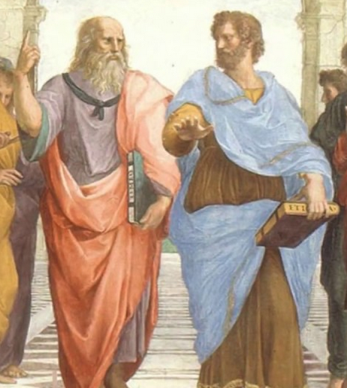
Want to talk more about ethics?
(Not right now!)
Dan Webber | webberdf@stanford.edu
Email to set up a meeting!

